Slide 1
INTERACTIVE POWER BI DASHBOARD FOR SUPERSTORE SALES ANALYSIS
DHIVYA DHARSHINI S K
MAY 30,2025

Slide 2
OBJECTIVE
Provide an interactive dashboard for business stakeholders to:
Monitor sales and profit performance
Identify top-performing products and regions
Analyze trends over time
Enable data-driven decision-making

Slide 3
DATA SOURCE
Dataset: Sample – Superstore
Key Columns:
Order Date
Sales
Profit
Category
Region/State
Product Name

Slide 4
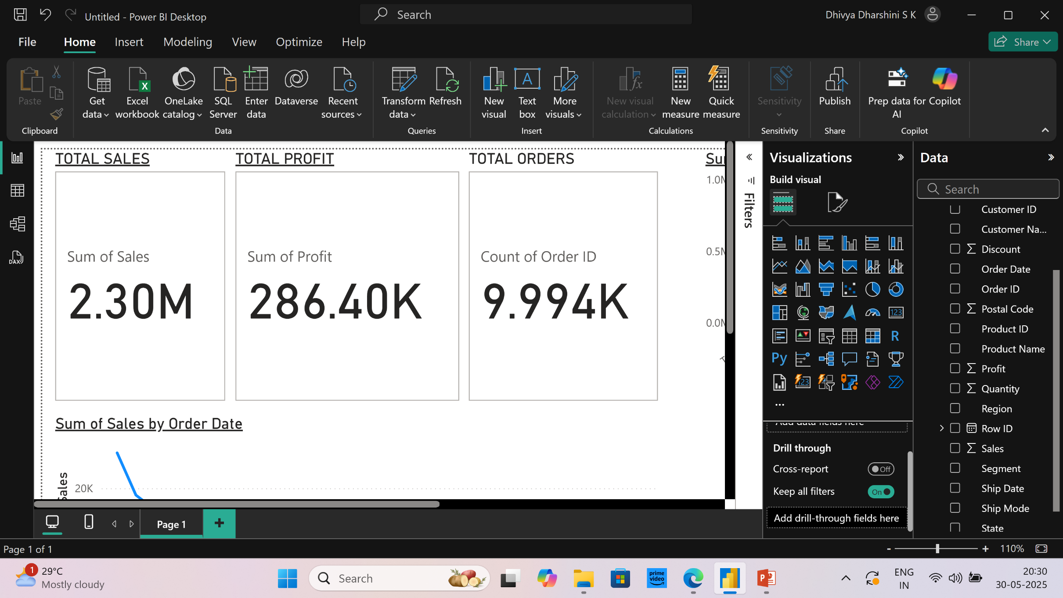
SUMMARY CARDS

Slide 5
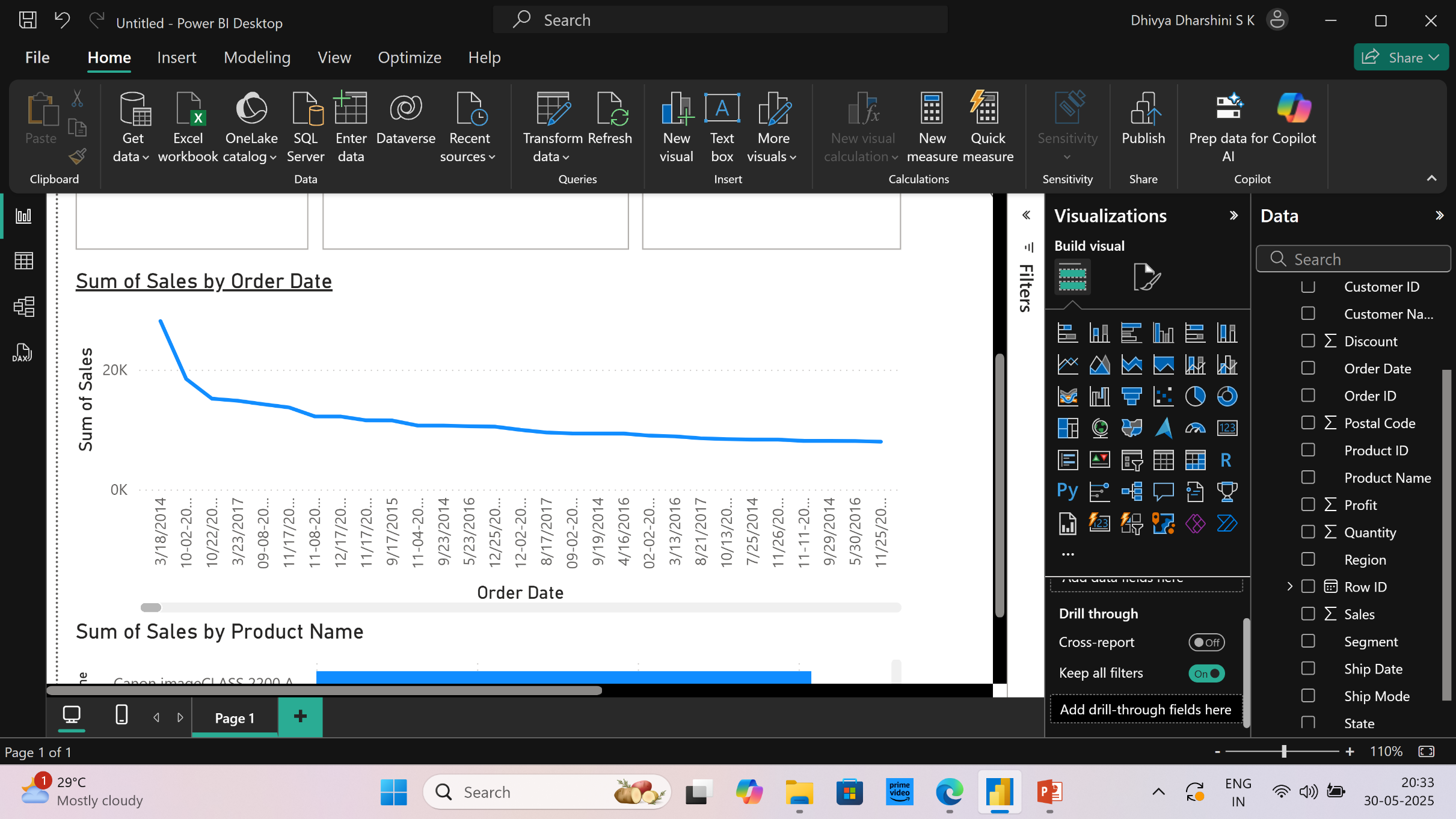
Time-Series Analysis

Slide 6
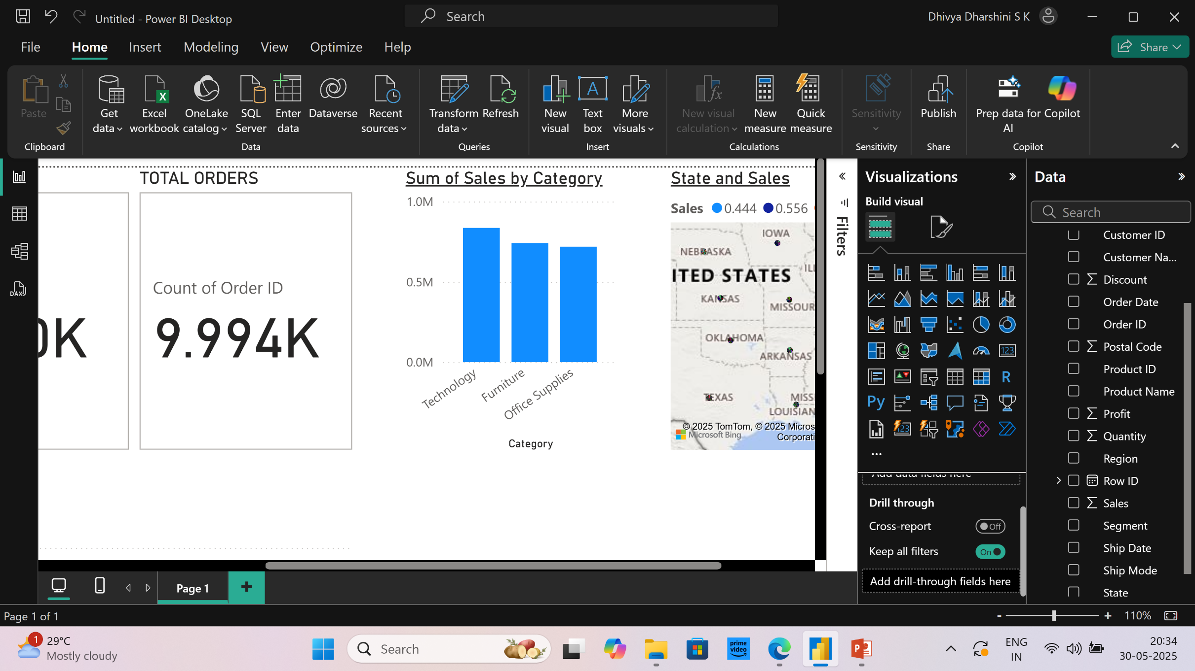
Sales by Category

Slide 7
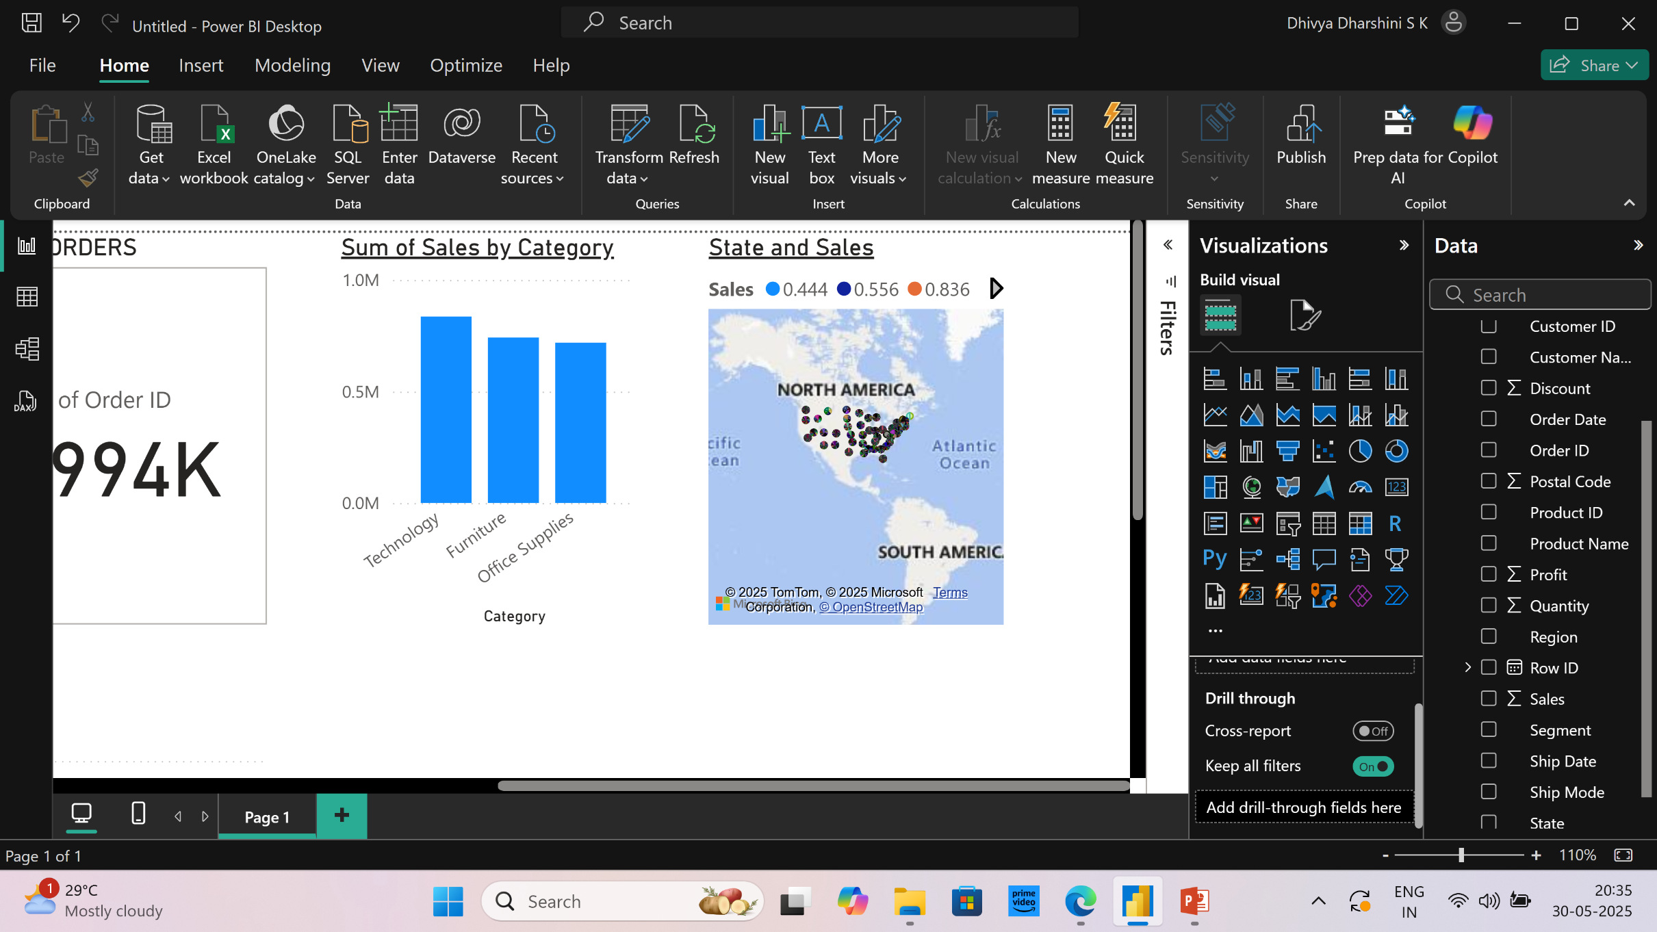
Regional Performance

Slide 8
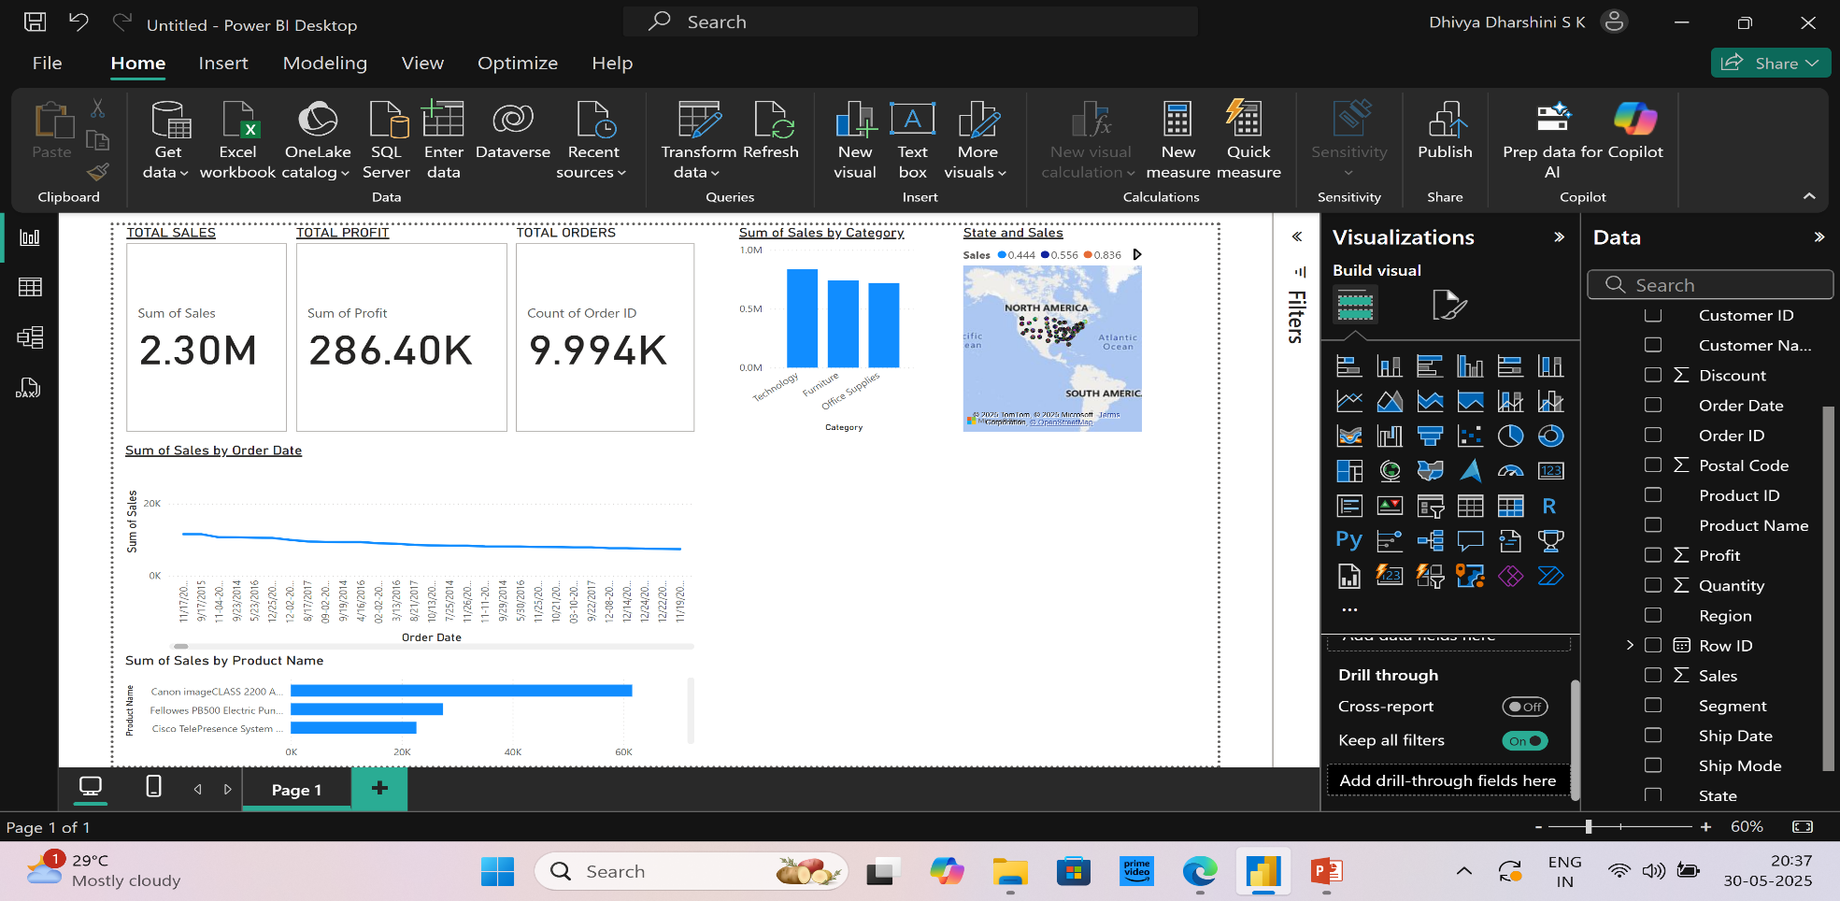
Top Products

Slide 9
KEY TAKEAWAYS
Focus on top-performing categories to maximize revenue and profit.
Investigate underperforming regions and identify opportunities for growth or targeted marketing.
Monitor seasonal and monthly sales trends to optimize inventory and supply chain planning.
Leverage interactive dashboards to enable data-driven decisions and track performance in real-time.

Slide 10
THANK YOU

